Slide 1
Battle of Neighbourhoods
Report on the Battle of Neighbourhoods
(Version 1.0)
Capstone Project
January 18, 2020

Slide 2
Outline of Presentation
Introduction/Business Problem
Scope/Limitations
Major Data Description
Methodology
Results and Discussions
Observations and Recommendations

Slide 3
Introduction/Business Problem
This business problem performs a comparison of the two cities, i.e. Toronto and New York to determine how similar or dissimilar they are based on available amenities or services within the areas.
This type of case or problem study was selected because it serves a lot of purposes other than selecting a place where to live or migrate.
Major target clients or stakeholders of this case or problem study are
individuals or families who are planning or deciding to live or migrateto Toronto or New York City
individuals who are planning or deciding to work or get employed in Toronto or New York City
a company who plans or looking for a location to expand
Data Scientists or data analyst who wants to do analysis on using technologies like machine learning techniques or other data science tools

Slide 4
Introduction/Business Problem
This business problem performs a comparison of the two cities, i.e. Toronto and New York to determine how similar or dissimilar they are based on available amenities or services within the areas.
This type of case or problem study was selected because it serves a lot of purposes other than selecting a place where to live or migrate.
Major target clients or stakeholders of this case or problem study are
individuals or families who are planning or deciding to live or migrateto Toronto or New York City
individuals who are planning or deciding to work or get employed in Toronto or New York City
a company who plans or looking for a location to expand
Data Scientists or data analyst who wants to do analysis on using technologies like machine learning techniques or other data science tools
The problem statement is: Is Toronto more like New York City before a family decides to migrate to Toronto?

Slide 5
Scope/Limitations
It will leverage or focus on the Foursquare location and available data to explore or compare the Toronto and New York cities and/or their neighbourhoods.
Statistical data depends on the source and date/time of last updates. See Section III – Major Data Description for the source references.
There is a limit on using Foursquare API. Since there are two (2) cities to be compared, the LIMIT was set to 50 and radius of 500 in running the programs for each city.

Slide 6
Major Data Description
It will leverage or focus on the Foursquare location and available data to explore or compare the Toronto and New York cities and/or their neighbourhoods.
Statistical data depends on the source and date/time of last updates. See Section III – Major Data Description for the source references.
There is a limit on using Foursquare API. Since there are two (2) cities to be compared, the LIMIT was set to 50 and radius of 500 in running the programs for each city.

Slide 7
Scope/Limitations
Data on postal codes of Toronto City, Canada
Data on geospatial data
Data on latitude and longitude coordinates of New York City, USA
Foursquare application credentials’ Data
Foursquare location data

Slide 8
Methodology
Business/Problem Understanding
Data Understanding
Data Preparation
Data Normalization
Exploratory Data Analysis
- Descriptive Statistics
- Group By
- Modelling : K-Means
6. Visualization

Slide 9
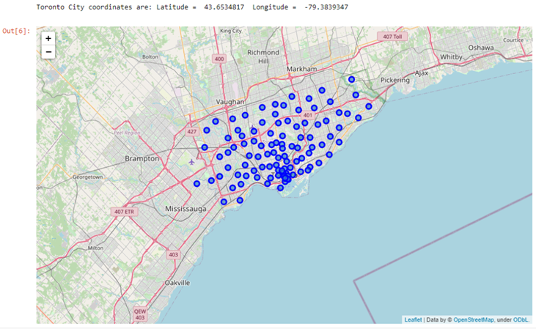
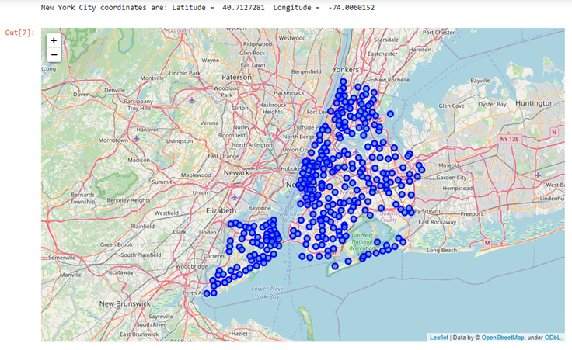
Results and Discussions
Toronto Map
New York Map

Slide 10
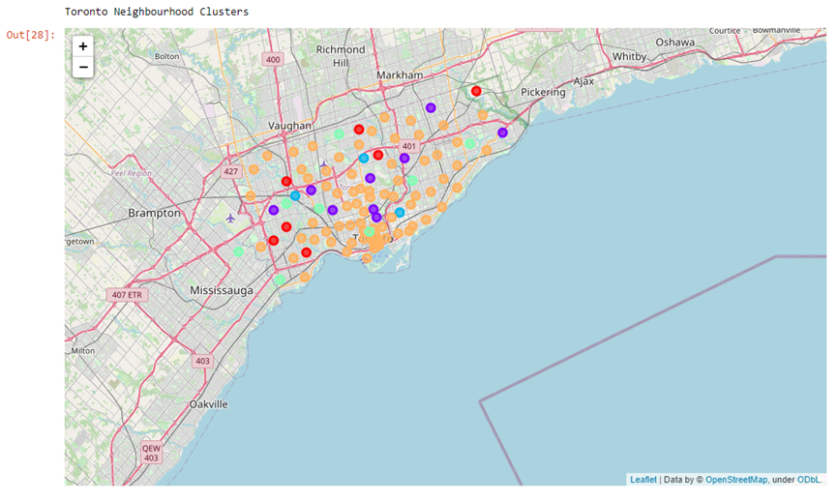
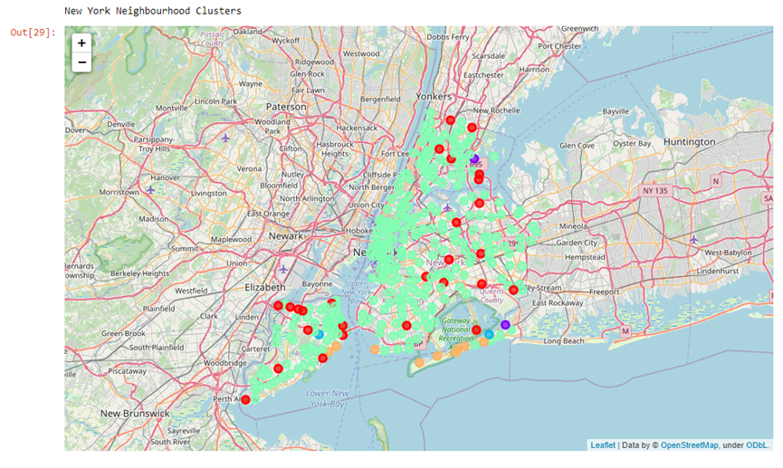
Results and Discussions
Toronto Cluster Map
New York Cluster Map

Slide 11
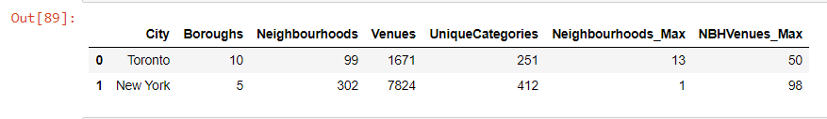
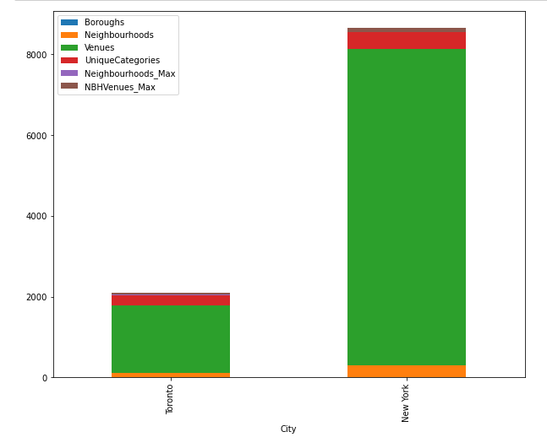
Results and Discussions
Similarities/Differences

Slide 12
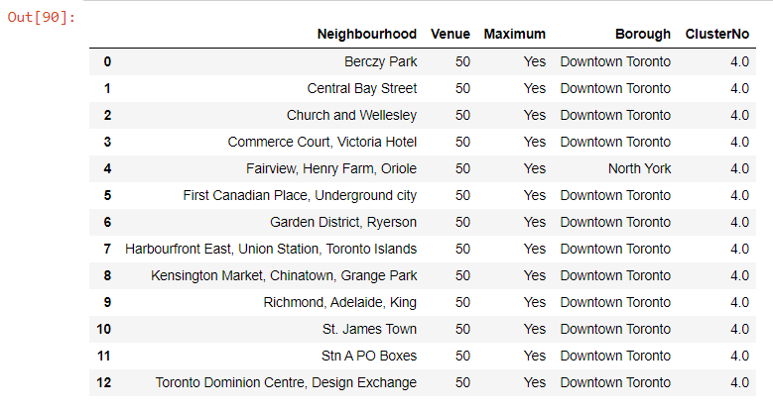

Results and Discussions
Top Number of Venues’ Categories
Toronto
New York

Slide 13
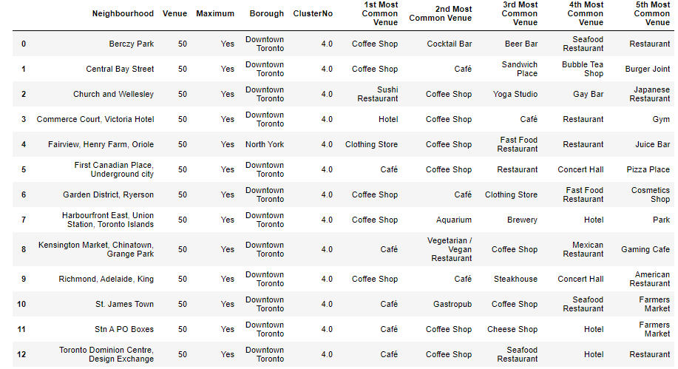
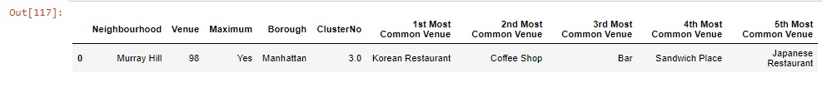
Results and Discussions
Top Five Common Venues
Toronto
New York

Slide 14
Observations & Recommendations
Observations:
There are different sources where one can get the applicable or appropriate data to be used or analyzed. One has to analyze its contents, structure, and other factors that will be needed for better use or appreciation.
Dataframes are powerful but one has to gain deeper understanding on how to do further manipulations and familiarity with the syntaxes.
There is a need to strategize beforehand on how the results can be presented for better understanding of the results towards decision making or conclusion.
As one executes a program code, there is a need to analyze further and comprehensively the results and do tests to confirm the accuracy of the data.
Recommendations based on the results:
K-means is a good model to use. In this case or problem study, the k-means clustering was executed beforehand. Further analysis using dataframes and analysis of data have confirmed its appropriateness and importance. Thus, recommendation is: one has to really focus on the data and do tests to confirm its accuracy.

Slide 15
Conclusion
Is Toronto more like New York City before a family decides to migrate to Toronto? Further review of the “more like" means something is better or more agreeable or satisfying. Based on Section VI Results, Toronto is more like New York City based on the following:
Toronto has more neighbourhoods that top the maximum number of venues category; and where a family deciding to migrate has several choices. New York has only one neighbourhood inspite of the fact that it has more venue categories.
13 neighbourhoods of Toronto have the same number of different venues’ categories which topped the list. A family has more choices when it comes to travelling within the area because the neighbourhoods belong to same cluster (Cluster 4) as well.
Further, since there are more neighbourhoods in Toronto to choose with wide variety of venues’ categories, a family deciding to migrate to Toronto may use the data with the list of neighbourhoods and its top 5 most common venues.

Slide 16
Thank You.

